Slide 1
QUESTION PAPER GENERATOR AND MODERATOR
PRESENTED BY:
Ashok Ghimire (18758)
Resarch Paija Pun (18771)
Sabal Thapa (18774)
Kishor Humagain (18791)
SUPERVISOR:
Er. Himal Chand Thapa
A PROJECT SUBMITTED TO DEPARTMENT OF COMPUTER AND ELECTRONICS ENGINEERING IN PARTIAL FULFILLMENT OF THE REQUIREMENT FOR BACHELOR’S DEGREE OF COMPUTER ENGINEERING
DEPARTMENT OF COMPUTER AND ELECTRONICS ENGINEERING
Date:21 May, 2022

Slide 2
Contents:
Introduction
Problem Statement
Objectives
Applications
Requirement Analysis
System Design
System Evaluation
Conclusion
References

Slide 3
INTRODUCTION
A design of suitable system for generating question papers.
An integrated system that stores questions related to a particular course.
Based on webpage.
Friendly user login interface.
Provisions to enter and edit data suitable to any educational organization.
Uses OCR and regular expression technique to scan pdf and store questions in database.
Our system aims to provide fast operations, data storage and high security for all its tasks.
Admin manages all the other entities of the system.

Slide 4
Problem Statement
The examination question paper generation method currently used is Zambia method.
Zambia method is time consuming and compromises the quality.
Risk of leakage of paper.

Slide 5
Objective
To store questions in database provided by many teachers.
To play vital role for the moderation of question papers.
To generate question paper in shorter period of time.

Slide 6
Applications
Can be used by all educational institutions for the quicker generation of papers.
Can also used by educational institutions when many sets of questions are to be generated at a time.

Slide 7
REQUIREMENT ANALYSIS
Hardware Requirements
Software Requirements
Client | Mobile, Computer Any PC above 2GB RAM Any mobile above 540 MB RAM
Developer | Computer Above (I5 7-Gen, CPU 1.8GHZ, 8-GB RAM)
Server | 3.6 GHZ or fast CPU 10GB HDD/5GB SSD(Developer specification for local host server)
Client | Web Browser Windows 7+
Developer | Visual Studio Code dbsqlite3, HTML, JS, CSS, Django Windows 7+ OS
Server | Django Live Server(Can be implemented in online server)

Slide 8
Functional Requirements
Sign in with unique login id
User interactive interface
Uploading raw questions for moderation
Select the subject in dashboard for question generation
View and Download question paper

Slide 9
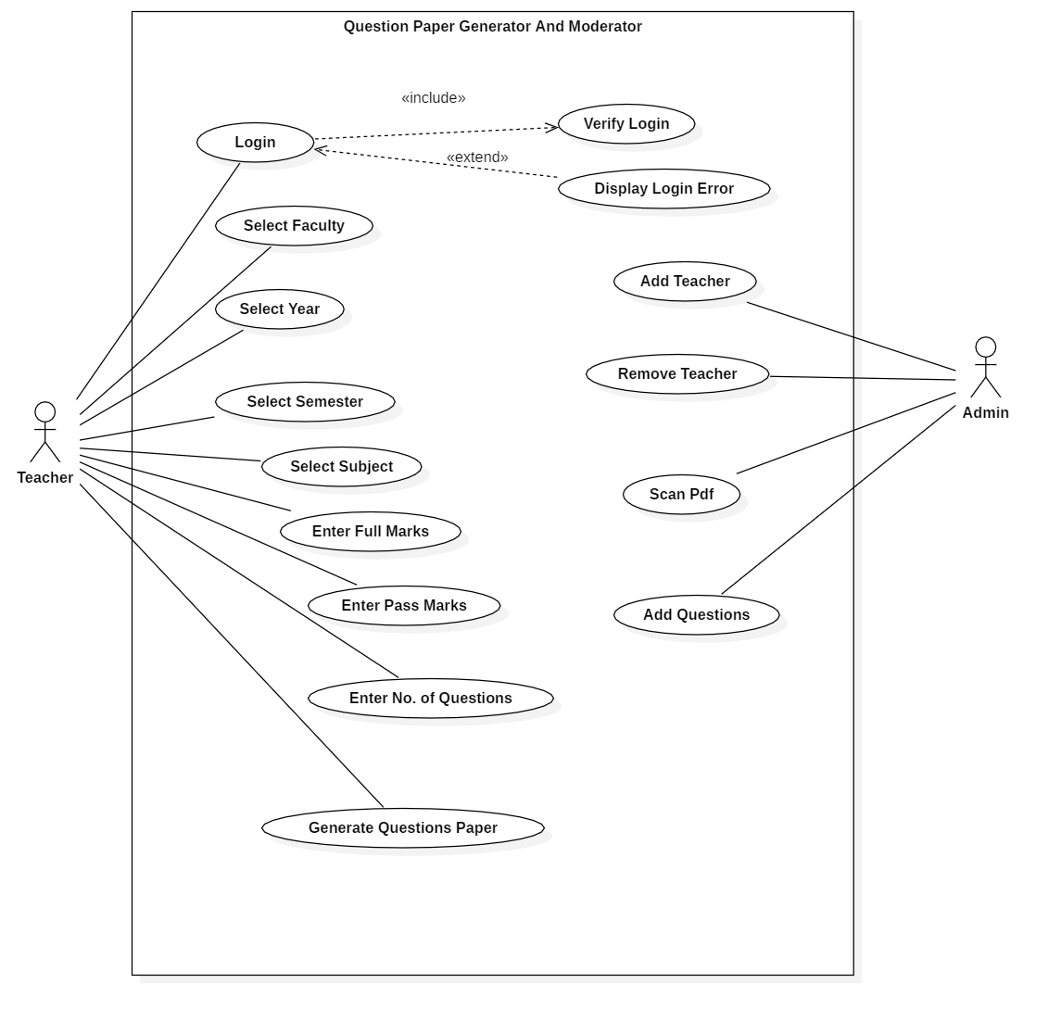
Use case diagram
Fig: use case diagram

Slide 10
Non-Functional Requirements
Secure user-id storage
24 hour availability when server is live
Faster scan operation by OCR
Faster Question paper generation
Flexible for future upgrade

Slide 11
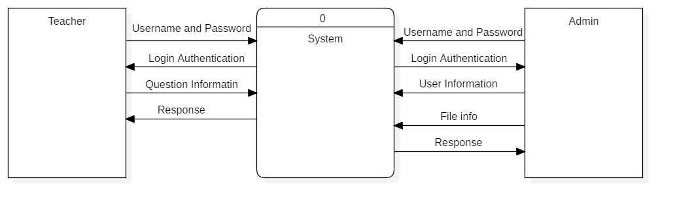
Data Flow Diagram(DFD)
System Design
Fig: DFD - level zero

Slide 12
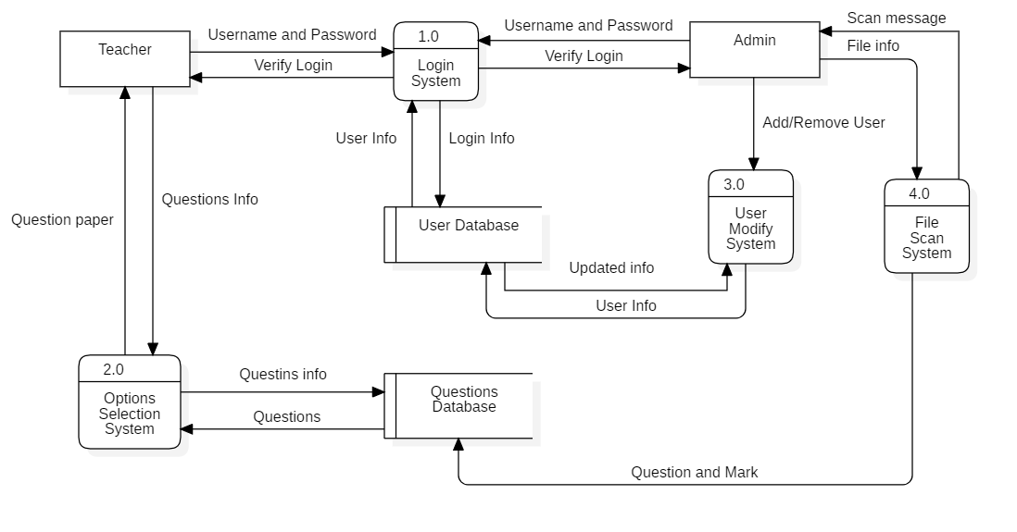
Data flow diagram(DFD)
Fig: DFD level - one

Slide 13
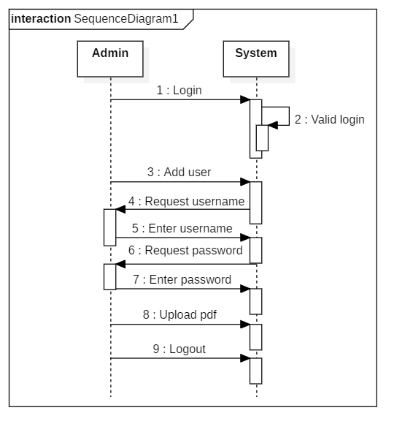
Sequence Diagram for Admin
Fig: Sequence diagram for Admin

Slide 14
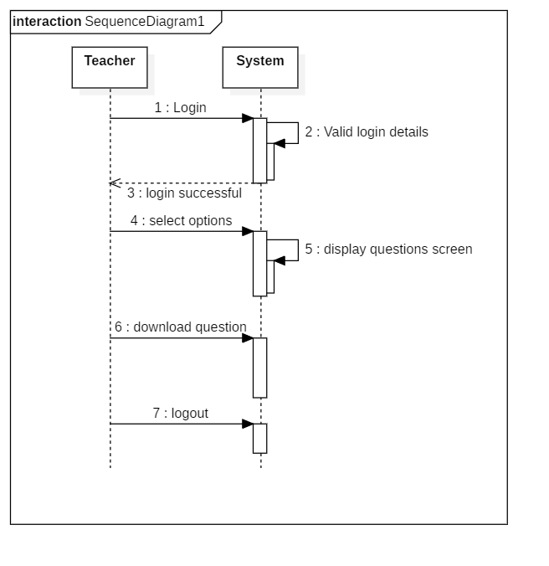
Sequence Diagram for Teacher
Fig: Sequence diagram for Teacher

Slide 15
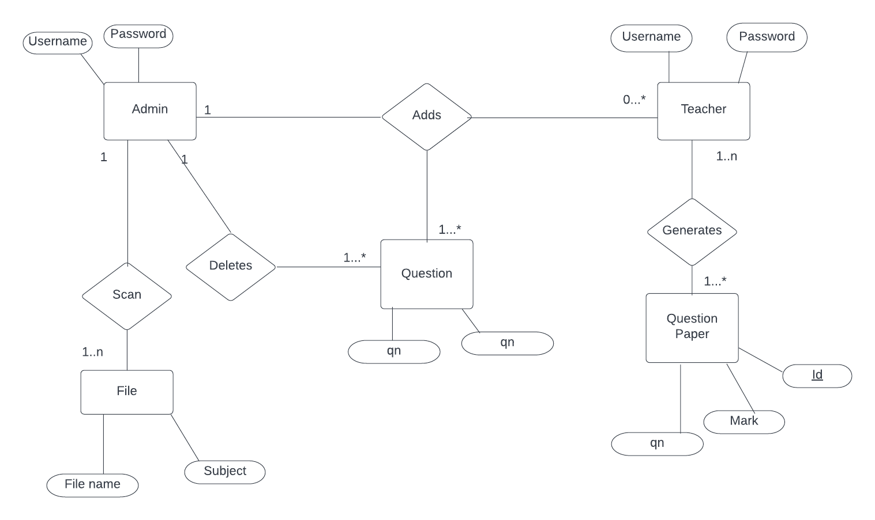
ER Diagram
Fig: ER Diagram

Slide 16
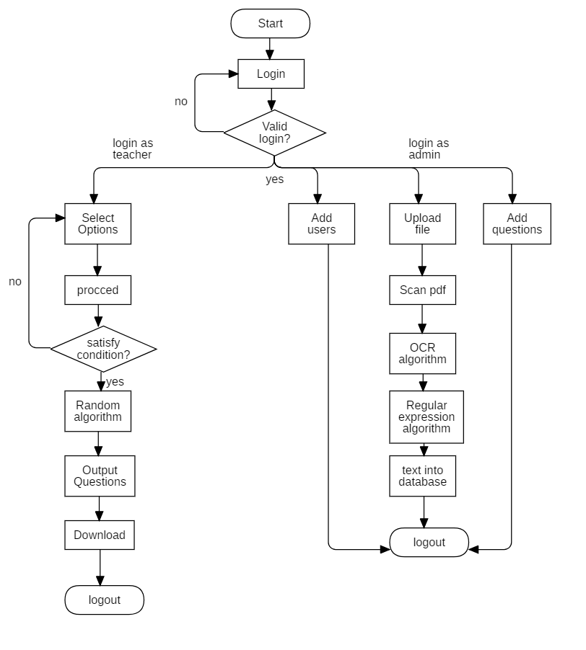
System flow diagram
Fig: System flow diagram

Slide 17
Methodology
Incremental Model
Incremental model is a process of software development where requirements are broken down into multiple standalone modules of software development cycle.
The product is decomposed into a number of components, each of which is designed and built separately (termed as builds).

Slide 18
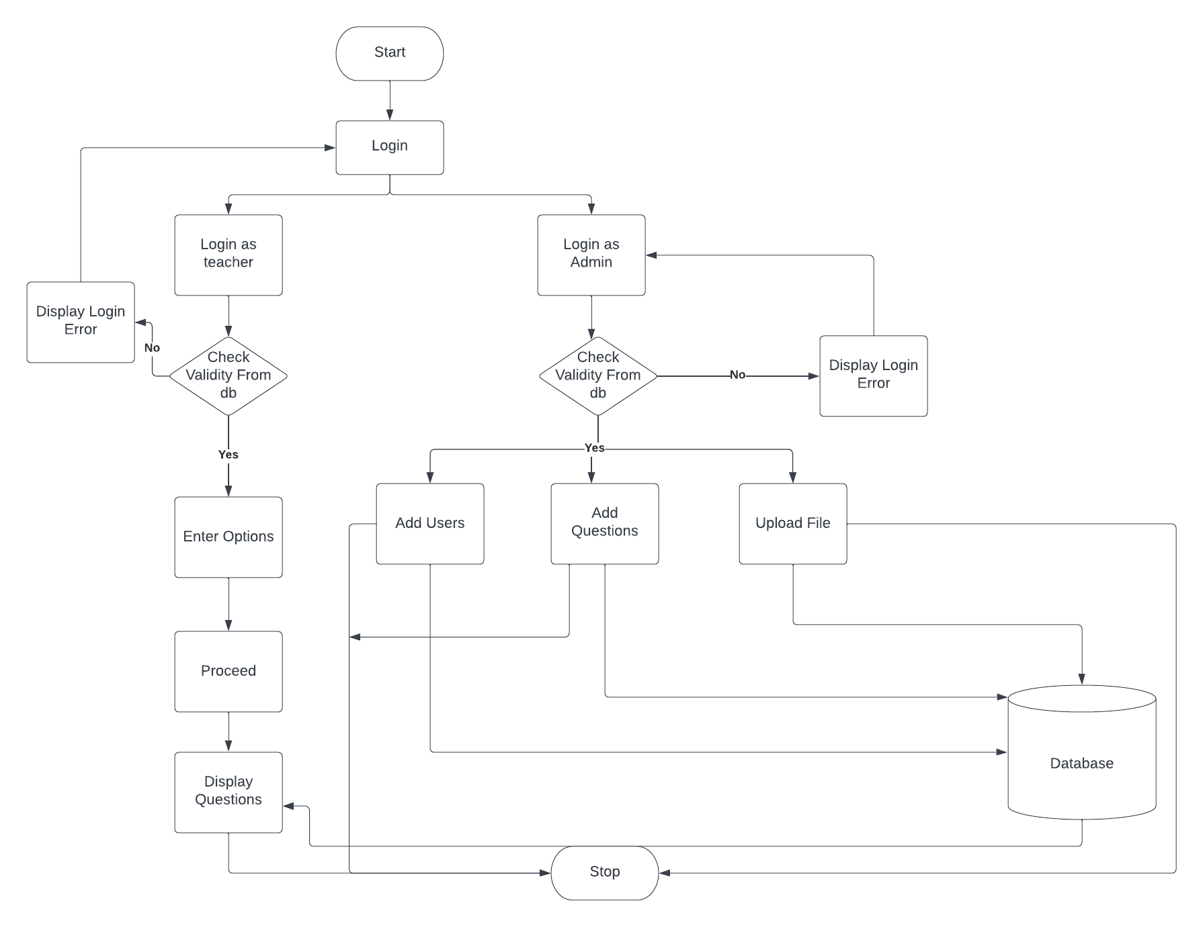
System Architecture
Fig: System architecture diagram

Slide 19
OCR
Optical character recognition or optical character reader (OCR) converts images of typed, handwritten or printed text into machine-encoded text.
Widely used as a form of data entry from printed paper data records – whether passport documents, invoices, bank statements.
Advanced systems capable of producing a high degree of recognition accuracy for variety of digital image file format inputs.

Slide 20
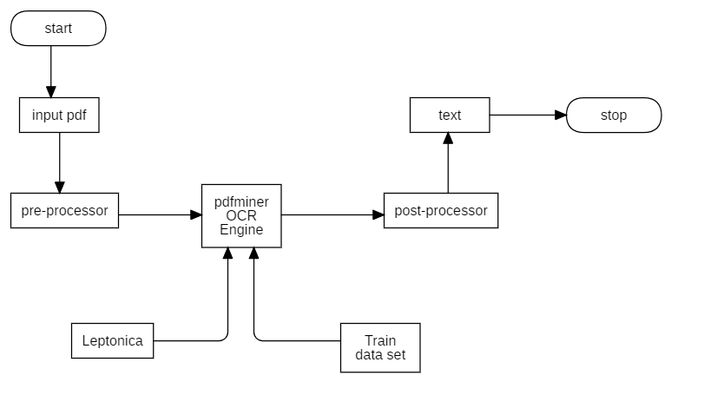
Flowchart of OCR
Fig: Flowchart for OCR

Slide 21
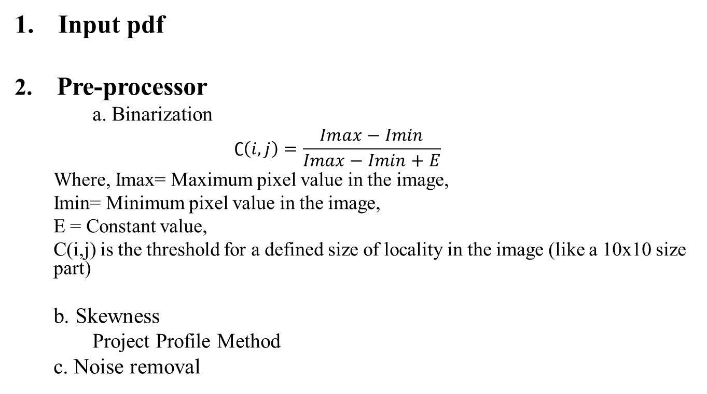
General steps of OCR working
Input pdf
2. Pre-processor
a. $\text{Binarization}$
$$∁\left(i,j\right)=\frac{Imax−Imin}{Imax−Imin+E}$$
Where, Imax= Maximum pixel value in the image,
Imin= Minimum pixel value in the image,
E = Constant value,
C(i,j) is the threshold for a defined size of locality in the image (like a 10x10 size part)
b. Skewness
Project Profile Method
c. Noise removal

Slide 22
3. OCR Engine
a. Leptonica
b. NIST dataset
Post-Processor
Cleaning faults in file like grammar errors, spelling errors etc.
5. Text Output

Slide 23
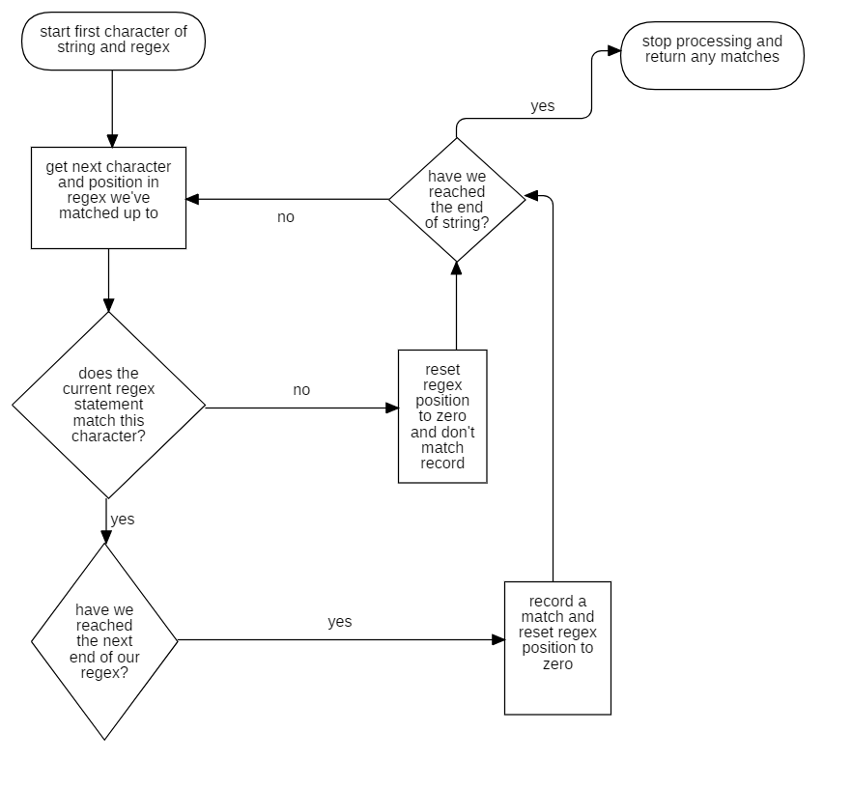
Regular expression
Fig: Flowchart for regular expression

Slide 24
System Evaluation
OCR process has successfully scanned the pdf file.
Questions with marks has been stored in database using regex.
Questions retrieved successfully from database .
Fast random generation of questions paper.
Error messages when invalid input.
Passed unit testing and integration testing.

Slide 25
Conclusion
We have developed a system that can be used to generate and moderate paper.
During the development of this project we used various resources like video tutorial, website, articles.

Slide 26
References
A. Khairnar, "“Automatic Question Paper"," “Automatic Question Paper", 2018.
M. Joisher, ""AutomaticQuestion PaperGeneration"," "AutomaticQuestion PaperGeneration", vol. 4, 2015.
P. Pisat, "“Question Paper Generator”," “Question Paper Generator”, 2017.
V. K. Purohit, "“Design of Adaptive Question Bank"," “Design of Adaptive Question Bank", 2012.
S. Mori, "“Historical Review of OCR Research and Development", 1992.
A. A. Chaudhary, “OCR of Bangla Character Using Neural Network", 2002.
The International Journal of Multi-Disciplinary Research on Examination System,, 2014.
Fonseca Cacho, Jorge Ramon, "Improving OCR Post Processing with Machine Learning Tools", 2019.
"www.youtube.com/Python Backend Web Development Course (with Django), free code camp channel," [Online].
"www.youtube.com/regular expression with Corey Schafer," [Online].
"https://docs.djangoproject.com," [Online].
C. Wood, "Explainthatstuff.com |OCR," [Online].

Slide 27
THANK YOU!!

